Slide 1
Monday, January 31st

Slide 2
Mythology KWL
Know | Want to Know | Learned

Slide 3
Why did people develop myths?
There was no science as we know it today!
Try to explain one of the following natural phenomena without using anything you have ever learned about science-
A Thunderstorm
The Seasons
Sunrise/Sunset
The Creation of the World/Universe

Slide 4
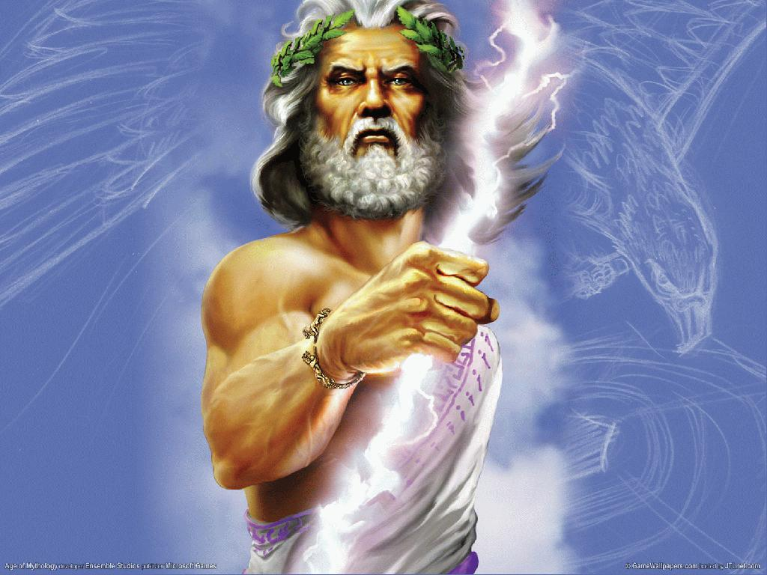
Thunderstorms
Zeus controlled weather
Storms meant that Zeus was angry

Slide 5
The Seasons
Zeus’s mistress Demeter controlled the seasons
Their daughter Persephone was kidnapped by the god of the underworld, Hades
Demeter could destroy all life, so Hades agreed to free Persephone

Slide 6
The Seasons Cont.
Persephone had eaten pomegranate seeds in the underworld, so she could not live without returning
Persephone had to return for 4 months out of the year
Her mother Demeter’s lonely depression created winter

Slide 7
Sunrise and Sunset
Helios, the sun god, drives his fiery chariot across the sky each day.
His sister, Selene, who was the goddess of the moon, made her trip at night.

Slide 8
Creation
Everything was a void, meaning empty space, known as Chaos
Then Gaia (the Earth) and Uranus (the sky) were formed
Gaia and Uranus fell in love and created the Titans, who later created the Olympian gods and goddesses

